Slide 1
Good governance Helping to deliver better public services for citizens
Andrew Burns
President, CIPFA
Director of Finance and Resources, Staffordshire County Council, UK
May 2018

Slide 2
Today’s talk
About CIPFA
The challenges of this generation
Why governance matters
What is the role of good governance?
Good governance and PFM
The International Framework: Good Governance in the Public Sector
Principles of good governance
Examples from the UK
Counter Fraud Centre protecting the global public purse

Slide 3
About CIPFA
The global professional accountancy body for people in public finance
Only professional accountancy body focused on public services
Partner with government bodies and professional accountancy organisations to improve PFM and Governance

Slide 4
The challenges of this generation
Energy and environmental security
Conflict and poverty
Globalisation
Global imbalances
Global health crises

Slide 5
Why governance matters
When poor governance impacts people’s lives
Detroit, US
Greece
Madrid, Spain
Governance done well
New Zealand

Slide 6
What is the role of good governance?
Assurance for the public and the Government that money is being spent effectively and efficiently
It supports management of risk and ensuring robust corporate governance
Provides information on performance and associated risks
Delivering improved cost effective public services
Impacts a country’s ability to achieve sustainable economic growth
Facilitates and stimulates reform
Limits abuse of power

Slide 7
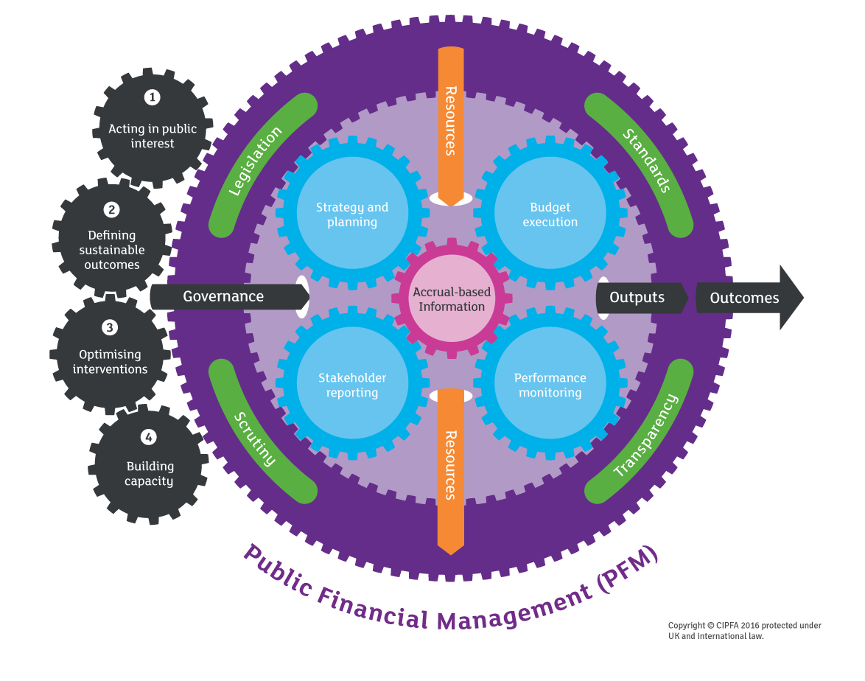
Strong public finance management

Slide 8
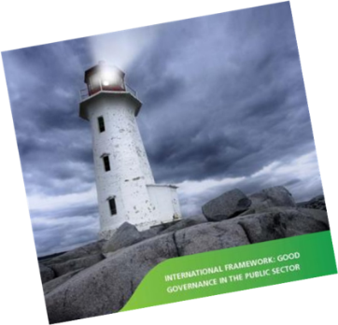
CIPFA / IFAC International Framework Good Governance in the Public Sector
Strong PFM integral to good governance and vice versa
Better service delivery and improved accountability
Acting in the public interest at all times

Slide 9
International framework principles
Behaving with integrity
Openness and engagement
Defining outcomes
Determining interventions
Capacity and capability
Managing risk and performance
Transparency, reporting and audit
Copyright © CIPFA 2016 protected under UK and international law

Slide 10
UK example: Assurance framework
Reliable information on the effectiveness of managing risks and control issues
Greater visibility of risk and control issues by providing view of assurance across risk environment
Identify gaps in assurance needs
Raise organizational understanding of risk profile, strengthen accountability, clarify ownership
Support production of the Governance Statement
Provide greater oversight on assurance activity
Better use of assurance skills and resources

Slide 11
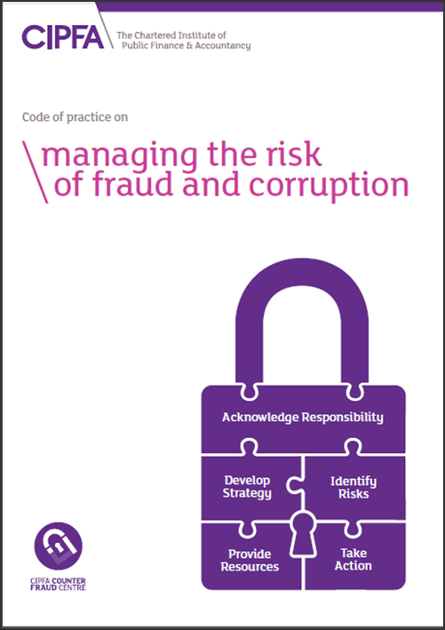
Counter Fraud Centre protecting the global public purse
Public Sector wide counter fraud service and professional support
Centre includes:
Detection and preventions tools & services
Qualification and CPD
Good Practice, including CIPFA Code
Good practice bank and cases studies
Network directory
Supplier listings
Newsletter
Alerts
Free toolkits e.g. packs on
vishing, mandate fraud, etc
© CIPFA

Slide 12
Questions and discussion
Andrew Burns President, CIPFA
President@cipfa.org

