Slide 1
Professionalisation leads to better governance and Public Financial Management
Gillian Fawcett
May 2018

Slide 2
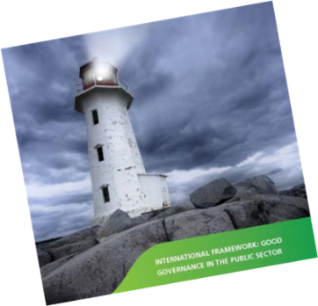
Good governance and accounting standards in public financial management are critical

Slide 3
Why?
Whatever the level of development or economic circumstances in a country, citizens keep raising the bar with regard to their expectations about public service delivery
Pressures on national budgets
Need to better understand the interrelationships between elements of Public Financial Management (PFM) and their unique special characteristics
Need to improve the performance of public services, transparency and accountability
Pressure to tackle fraud and corruption

Slide 4
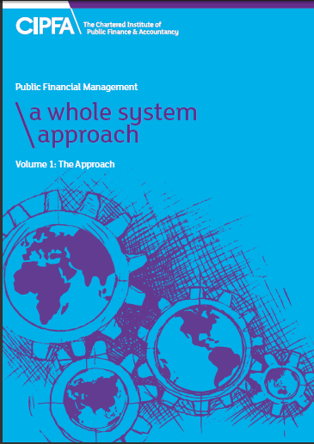
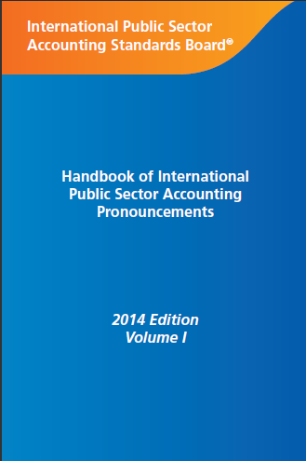

High Quality PFM requires (at least)…

Slide 5
Whole Systems Approach (WSA)- Overview
The overall architecture is a key aspect of the PFM environment – global, regional and national bodies
Strong PFM requires good governance (leadership, visioning and planning, performance and risk management, transparency and accountability)
Recognises multiple stakeholders – citizens, service users and delivery organisations etc.
Highlights the coordination and collaboration of interests in originating and prioritising policies and programmes
Highlights the need to build capacity.

Slide 7
Professionalisation
We define professionalisation as the achievement of a number of complementary states of affairs. This includes:
  The establishment of a PFM profession in any country, represented by a body or institute, and for it to have qualified members
  Public finance leaders, managers and employees having the skills and support to carry out their duties transparently and effectively
  Building capacity in local organizations to provide training, products and services to support managers in their roles.

Slide 8
Aims of Professionalisation
At the core of a finance function, the aims of professionalisation should be:
  Better support of service delivery
  The establishment and maintenance of a recognised Public Financial Management (PFM) profession
  Non-financial managers with the skills, support and other resources to play their part in PFM, including taking responsibility for the resources they manage and formulating and controlling their budgets
  Capacity locally to provide the training, continuing professional education and experience required.

Slide 9
Benefits of professionalisation
Mutually beneficial for both service providers and customers because, typically:
  citizens benefit from government’s increased ability to target development effort that results from professionalising PFM
  government benefits from the improved quality of PFM that comes from having properly trained professionals doing the work
  finance staff benefit from access to well designed qualifications that offer the potential for increasing employability and long term skills development

Slide 10
Benefits of professionalisation
  managers and staff with financial responsibilities working in government gain access to improved skills and therefore the potential to improved job performance and opportunities for promotion
  local education and training providers gain access to additional markets that allow them to increase their revenues and diversify their offerings
  donors benefit from being able to place greater reliance on the accuracy and integrity of information produced by government, and from being able to make greater use of country systems

Slide 11
Planning to professionalise
Develop a vision for numbers and skill levels
Deliver the vision through:
  Public sector specific provision based upon existing training/professional qualification routes
  Tailored training
  Mentoring
  Training for experienced but non-qualified staff
  Building continuing professional development provision
  Career development and support

Slide 12
Vision
The time horizon – when?
Why is there a need – PFM reform programme; transition to a new accounting framework; new system implementation plans?
Looking forward to a steady state in terms of:
  AAT/part qualified
  Professionally qualified accountants
  Financially aware non-finance staff

Slide 13
Delivering the vision (1)
Public sector specific provision:
  Education
  Training
  Competencies and skills
  Professional qualification
  Regulation and governance
Development of a Government Finance Profession:
  Mentoring
  Building continuing professional development provision
  Career development and support

Slide 14
Delivering the vision 2 (UK example)
A Government Finance Profession:
  A single individual with Head of Profession responsibility for finance staff across government supported by designated individuals leading finance within ministries and departments
  A unified pay and grading structure supported by a common skills and competence framework
  Clear arrangements for the continuing professional development of individuals including appropriate experience and progression
  A common recruitment and retention policy based upon an analysis of current and future needs across government

Slide 15
Delivering the vision (3)
Reward experience
    Training for experienced but non-qualified staff – ‘fast track’
Structural reform?
  Devolved finance functions within individual ministries?
  a Central Finance Agency in the Ministry of Finance – the Office of the Accountant General?
Creation of a Finance Stream?

Slide 16
Professionalisation in Zimbabwe
DFiD/IFAC funded project – began in 2016
National government, rural and urban local authorities
Public Accountants and Auditors Board (PAAB), Ministry of Finance, Auditor General’s Office
Public Services Commission, 13 Government training Centres
Eight Professional Accountancy Bodies registered with the PAAB – 2 pilot bodies identified to strengthen qualification for the public sector
Donors – European Commission, World Bank, IMF, DfiD, US Aid
IPSAS implementation plan currently in process – deadline August 2018
Public Accountants and Auditors Board (PAAB) announced a 10 point change plan in March 2018
New governance structures established within Ministry of Finance to take forward implementation

Slide 17
Professionalisation in Zimbabwe
Planning to integrate public sector element in qualifications
Accelerated route programme – one body
Potential public services commission & government training centres involvement – delivery of a diploma is an option
IPSAS training

Slide 18
Other professionalisation developments
Public Sector elements within ICASL qualification (CIPFA/ICASL Memorandum of Understanding (MoU))
World Bank competency framework for financial reporting
AFROSAI-E competency framework
Philippines Government adoption of a competency framework for finance staff

Slide 19

CIPFA support for public sector
Practical
support for
professionals &
key local institutions
(qualifications, Code of
Ethics etc)
Having acquired the
capacity CIPFA’s role
changes to become more of
A mentoring one
Association of PFM professionals
on a global scale providing advice
and influencing the global community

Slide 20

Thank you – Any questions?

