Slide 1
FISCAL POLICY:
South Asia in Perspective
SAFA Conference 2016
South Asia: Corridor of Opportunities
Enrique Blanco Armas,
Lead Country Economist, The World Bank, Islamabad
January 30, 2016

Slide 2
South Asia is the fastest growing region lately amongst developing countries …

Slide 3
...with most of the countries growing above 5 percent on average!

Slide 4
Current accounts remain broadly balanced across South Asia …

Slide 5
… helped by strong remittances that have offset relatively weak export performance!

Slide 6
… while net FDI flows remained weak at best!

Slide 7
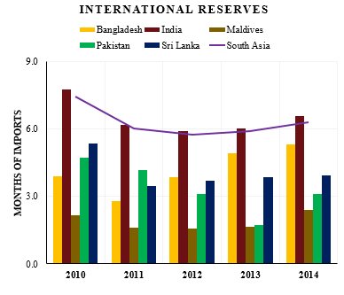
… but capital flows remained sufficient enough to replenish FX buffers!

Slide 8
South Asia’s fiscal deficit are decreasing gradually but remain high relative to most other regions!

Slide 9
Governments in the region are collecting very little revenue, which affects the avaialable fiscal space for priority spending

Slide 10
Subsequently, despite some consolidation efforts, South Asia’s debt-to-GDP ratio is the highest among developing regions!

Slide 11
Revenues in Pakistan are increasing but not as fast as expected!
(Percent of GDP) | 2013/14 |  | 2014/15 |  | 2015/16
 | Orig. Proj.* | Actual | Orig. Proj.* | Actual | Orig. Proj.* | Curr. Proj.^
Revenue and Grants | 14.4 | 15.3 | 14.8 | 14.5 | 15.3 | 15.5
Of which: Tax Revenue | 10.8 | 10.5 | 11.8 | 11.0 | 12.4 | 12.2
Overall Fiscal Balance | -5.5 | -5.7 | -4.4 | -5.4 | -3.6 | -4.3
* IMF 2013 Request for an Extended Arrangement under the EFF
^ IMF 2015 Ninth Review under the Extended Arrangement

Slide 12
Rigidity in recurrent spending for Pakistan has made fiscal consolidation challenging!

Slide 13
Public debt is only gradually declining, but composition is improving
Trends in Public Debt
Maturity Profile of Domestic Debt

Slide 14
Challenges confronting Pakistan
Like rest of South Asia, the country lacks fiscal or external buffers to be utilized in the event of a shock.
Low revenue levels results in limited space for priority spending:
  Growing infrastructure needs
  Pakistan spends less than 3% of GDP in health and education together, significantly lower than most other countries (~5% on education, 3-4% on health).
Significant rigidity in recurrent spending – with almost 100% of recurrent spending ‘non-discretionary’.

