Slide 1
Water- Economic Lifeline for
Pakistan
ICAP SAFA Conference 2016
South Asia: Corridor of Opportunities
Lahore, January 30, 2016
Mirza Hamid Hasan

Slide 2
Introduction
Water - life for all living beings.
It is also a lifeline for all modern economies as it has large scale uses in agriculture, industry, energy, mining and construction sectors.
Water has a special significance for Pakistan’s agriculture-based economy.

Slide 3
Pakistan’s Water availability
Availability of water per capita in Pakistan is decreasing every day due to increasing population, economic development and other factors.
Pakistan’s population has grown from a mere 30 million in 1947 to about 200 million in 2015.
As a result, water availability has decreased from 5000 cubic metres per capita in 1951 to less than 1000 m³ per capita now, making us a water- scarce country.

Slide 4
Contribution of Agriculture in Pakistan’s Economy
Agriculture is the mainstay of Pakistan’s economy:
- 23% of GDP comes from agriculture.
- It is vital for our food security.
- It is the main source of sustenance for our rural population forming 55% of the whole.
- Employs more than 50% of our labour force.
- Supports our largest crops of wheat and cotton and large industries like textile and sugar.
- Our main exports are based on agriculture.

Slide 5
(Contd…)Contribution of Agriculture in Pakistan’s Economy
Most important crops are wheat, sugarcane, cotton, and rice, which together account for more than 75% of the total crop output in value.
Pakistan is a net food exporter, exporting rice, cotton, fish, fruits and vegetables.
As Pakistan has an arid climate its agriculture is heavily dependent on canal irrigation.
Groundwater is another important source of irrigation water.

Slide 6
Water for Irrigation
Most of the irrigated agriculture takes place in the Indus Plain.
The area is served by the largest integrated canal irrigation system in the world.
It is dependent on the river Indus and its tributaries.
Ninety-three percent of our harnessed water from this river system is used for irrigation.
The remaining 7% meets all other needs like drinking and domestic water supply, industry, energy and environment etc.

Slide 7
Pakistan’s Irrigation Needs
Pakistan receives an average of 144 Million Acre Feet (MAF) of fresh water annually from the Indus River system comprising the Indus main and its tributaries.
Out of this 104 MAF is diverted to the canal irrigation system of the Indus Basin.
Another 50 MAF of water used for irrigation and domestic water supply is drawn from groundwater sources.

Slide 8
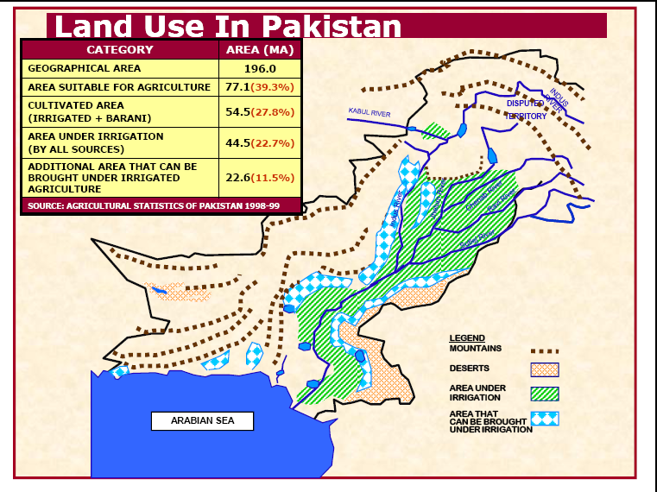
Indus Basin River System

Slide 9
Irrigation Infrastructure
The Canal Irrigation System of the Indus Basin comprises the following infrastructure:
No. of major Reservoirs 3
No. of Barrages 16
No. of Head works 2
No. of Inter-River link Canals 12
No. of Canal Systems 44

Slide 10
(Contd..) Irrigation Infrastructure
Length of Canals 56,073 km
Length of Watercourses: 1.6 million km
Average Canal Water Diversions 104 MAF
Groundwater Abstractions 50 MAF
No. of Tubewells 1 million
Irrigated Area 36 million acres

Slide 11
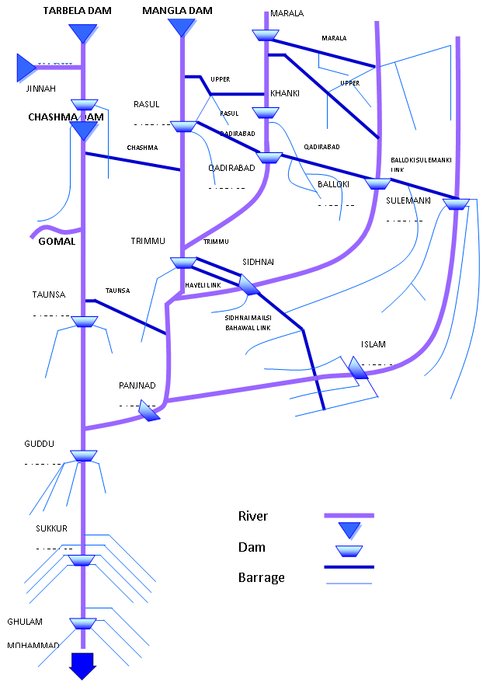
Schematic Sketch of IBIS

Slide 12
Challenges on the Water Front
Dwindling water availability.
Inadequate storage capacity.
Outdated and wasteful irrigation practices.
Traditional high water consuming agricultural practices.
Unregulated groundwater pumping.
Water quality.
Lack of water budgeting and water conservation.

Slide 13
(contd…) Challenges on the Water Front
Inadequate financial resources for O&M of water infrastructure and development of water resources.
Climate change impacts.
Absence of regional cooperation in water resources management.

Slide 14
Challenges Create Opportunities
I. Opportunities for Private Investment
Building new storages.
Constructing water conservation schemes.
Manufacturing and installing high efficiency irrigation equipment.
Manufacturing, marketing or renting agricultural equipment for raising farm water productivity.
Local investment for providing low cost but hygienic bottled water for drinking.

Slide 15
(Contd…) Challenges Create Opportunities
Opportunities for private sector to undertake O&M work of irrigation infrastructure.
Job and investment opportunities emerging in climate change mitigation and adaptation projects.
II. Opportunities for FDI
Construction of multipurpose dams for additional storage would create FDI opportunities.
Investment opportunities in renewable energy projects, necessary for climate change mitigation and adaptation.

Slide 16
(Contd…) Challenges Create Opportunities
III. Opportunities for Regional Water Cooperation
Cooperation in trans-boundary water sharing.
Joint venture projects for trans-boundary water management.
Trans-boundary investment in hydel energy projects on benefit-sharing basis.
Cooperation in information sharing with regard to floods as well as other impacts of climate change.

Slide 17
.
Thank You

